Slide 1


Slide 2


PORTFOLIO WEBSITE
Second Year Project Synopsis
Submitted by
ROLL | NAME
2301730132 | Shubhi Tyagi
2301730119 | Aryan Sharma
Industry Mentor: Sohan Phadikar
Faculty Mentor: Ritu Chauhan
Notes:
New Courses replaced with New Programmes

Slide 3

Project Overview
In the digital age, a personal portfolio website has become an essential tool for professionals across various industries. It serves as a dynamic showcase of an individual’s skills, accomplishments, and aspirations, offering a centralized platform to present their professional journey in a compelling and interactive manner. This project aims to explore the significance of personal portfolio websites and provide comprehensive guidance on creating an effective online presence that resonates with the target audience.
Objectives:
The primary objective of this project is to empower individuals to create an impactful personal portfolio website that effectively communicates their unique value proposition and enhances their career prospects. Specifically, the project aims to:
• Educate individuals about the importance of personal branding and online presence in today’s competitive job market.
• Provide practical insights and best practices for designing, developing, and optimizing a personal portfolio website.
• Equip participants with the necessary skills and resources to craft a standout online showcase of their skills, accomplishments, and aspirations.
• Empower individuals to leverage their personal portfolio website as a strategic tool for career advancement, networking, and professional growth.
Notes:
New Courses replaced with New Programmes

Slide 4
PROBLEM STATEMENT
1-In the digital age, standing out in a competitive job market is increasingly challenging.
2-Traditional resumes and generic online profiles are limited in showcasing an individual’s full potential.
3-Many professionals lack a dynamic platform to highlight their skills, achievements, and aspirations.
4-This gap leads to missed opportunities in career advancement, networking, and personal branding.
5-There is a need for a strategic, engaging, and customizable online presence.
6-A personal portfolio website offers a powerful solution to bridge this gap and empower individuals professionally.
Notes:
New Courses replaced with New Programmes

Slide 5
Key Features
1. Customization: You can make your website look however you want, with colors, fonts, and layout that reflect your style and personality.
2.Project Showcase: Show off your best work with pictures, descriptions, and links to projects you’ve completed or things you’ve made.
3. About Me Section: Introduce yourself and tell visitors a bit about who you are, what you do, and what you’re passionate about.
4. Resume/CV Integration: Put your resume or CV online so people can see your education, work experience, and skills easily.
5. Contact Information: Make it easy for people to get in touch with you by including your email, phone number, or links to your social media profiles.
6. Testimonials or Recommendations: Share positive feedback from past clients, employers, or colleagues to show others how great you are to work with.
7.Responsive Design: Your website will look good and work well on all devices, like phones, tablets, and computers.
Notes:
New Courses replaced with New Programmes

Slide 6
Project Usecases & Scope
Use Cases:
1. Job Search: Showcasing skills and experiences to potential employers.
2. Freelancing or Consulting: Attracting clients and showcasing expertise.
3. Personal Branding: Establishing a strong online presence and identity.
4. Educational Purposes: Highlighting academic achievements and projects.
Scope:
1. Design and Development: Creating a visually appealing and functional website.
2. Content Creation: Writing engaging content for “About Me” and project descriptions.
3. Visual Branding: Defining consistent visual elements like colors and fonts.
4. Feature Integration: Adding sections for projects, resume/CV, and contact information.
5. Responsive Design: Ensuring the website works well on all devices.
6. SEO Optimization: Improving visibility in search engine results.
7. Analytics and Tracking: Monitoring website traffic and user behavior.
8. Maintenance and Updates: Regularly updating content and security measures.
Notes:
New Courses replaced with New Programmes

Slide 7
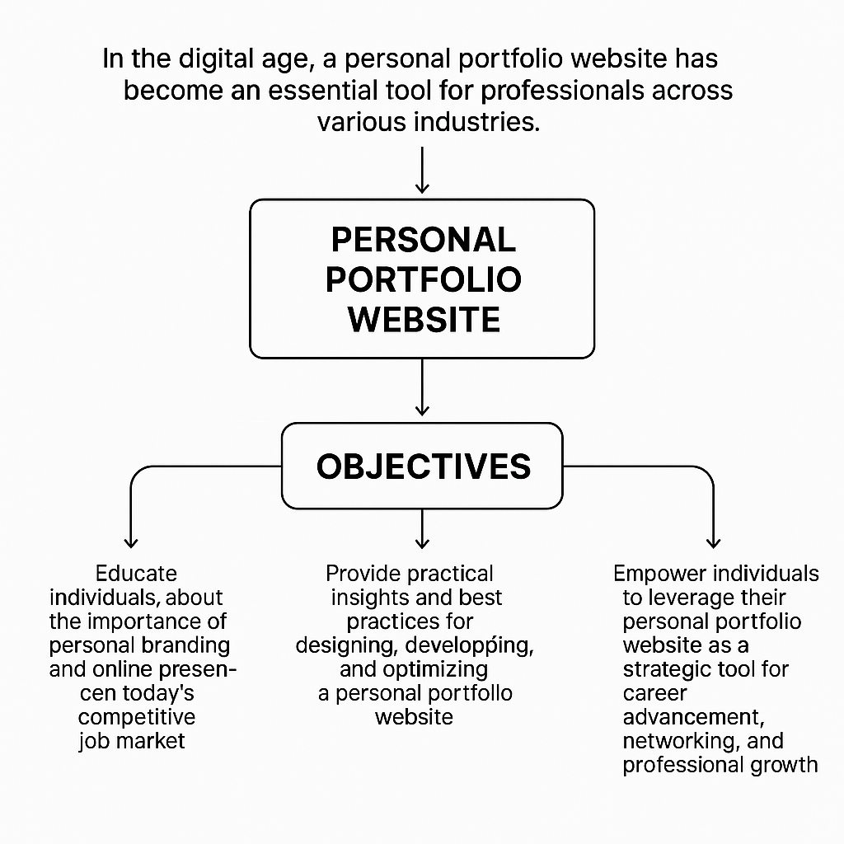
Prototype/Project Flow diagram/Architecture
Notes:
New Courses replaced with New Programmes

Slide 8
Data & Resources
Data:
1. Statistics on Job Market Trends: Information about the increasing importance of online presence and personal branding in job searches.
2. Survey Data: Surveys or studies on the effectiveness of personal portfolio websites in career advancement and networking.
3. Website Analytics: Data on website traffic, user engagement, and conversion rates from existing personal portfolio websites.
4. Industry Trends: Insights into emerging trends in web design, digital marketing, and personal branding within specific industries.
5. Case Studies: Examples of successful personal portfolio websites and their impact on career development.
Resources:
1. Website Builders: Platforms like WordPress, Wix, and Squarespace offer templates and tools for building personal portfolio websites without coding.
2. Coding Resources: Online tutorials, courses, and forums for learning HTML, CSS, JavaScript, and other web development languages.
3. Design Tools: Graphic design software like Adobe Photoshop, Illustrator, or online tools like Canva for creating visual assets and mockups.
4. Content Creation: Writing guides, resume templates, and online portfolio examples for crafting compelling content.
5. Analytics Tools: Platforms like Google Analytics for tracking website traffic, user behavior, and performance metrics.
6. Networking Platforms: Professional networking sites like LinkedIn for connecting with peers, mentors, and potential collaborators.
Notes:
New Courses replaced with New Programmes

Slide 9
Methodology
Explain the approach or methods you used to tackle the problem.
Include any tools or technologies utilized.
Notes:
New Courses replaced with New Programmes

Slide 10
Expected Results & Impact
Expected Results:
1. Enhanced Online Presence: A polished personal portfolio website showcasing skills and accomplishments.
2. Increased Visibility: Attracting more visitors through SEO and promotion.
3. Improved Networking: Connecting with peers, mentors, and potential clients.
4. Career Advancement: Standing out in the job market and attracting new opportunities.
Potential Impact:
1. Professional Branding: Establishing a strong online presence and credibility.
2. Career Growth: Attracting new career opportunities and partnerships.
3. Networking and Collaboration: Facilitating connections with industry professionals.
4. Skill Development: Enhancing skills in web design, content creation, and digital marketing.
5. Confidence Building: Boosting confidence and empowering pursuit of new challenges.
Notes:
New Courses replaced with New Programmes

Slide 11
THANK YOU

